Slide 1

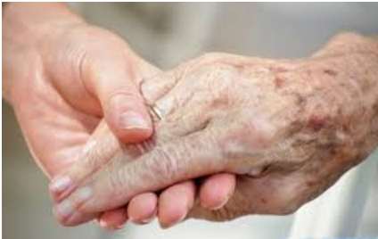
Government funding & SYDNEY RESIDENTIAL Aged Care technical presentation
Is residential aged care a good business model?
Emotional aspects towards aged care
government funding influencing factors

Slide 2
Definitions & data sources
Definitions: Residential aged care - A special-purpose facility which provides accommodation and other types of support, to frail and aged residents. Residential Bed, Bed or Place - A bed, a patient is accommodated
Data sources: Australian Bureau of Statistics Department of Health – Ageing and Aged Care Aged Care Reviews website Whirlpool Forum website

Slide 3
Assumptions & focus area
Assumptions: Future residential beds = occupancy + population above 65 years All other factors impacting the care are sufficient and remains constant Location of the facility selected may not be the location where the person has lived majority of their life Government funding provided = 2017 numbers for each facility Estimated population is based on high fertility (A_65)
Focus area: State of NSW Sydney suburbs Population 65 years old and above

Slide 4
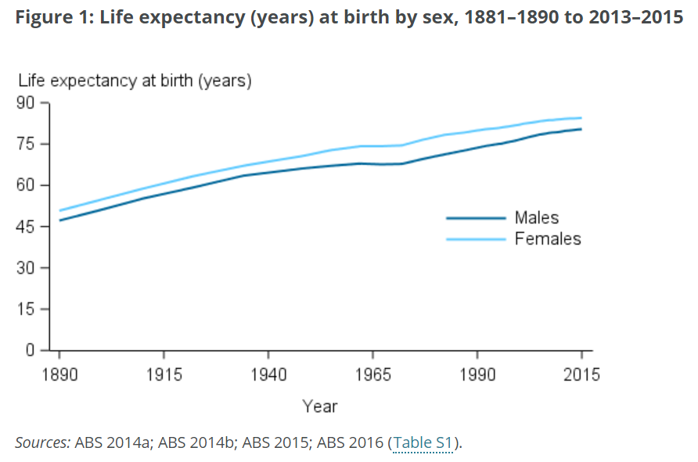
introduction
The Australian population is living longer due to better living conditions and medical breakthroughs. The Australian bureau of statistics predicted that the Australian population will live past 80 years old
increased pressure in life hinders family for being physically responsible for their aged
Hence the growth of residential aged care facilities

Slide 5
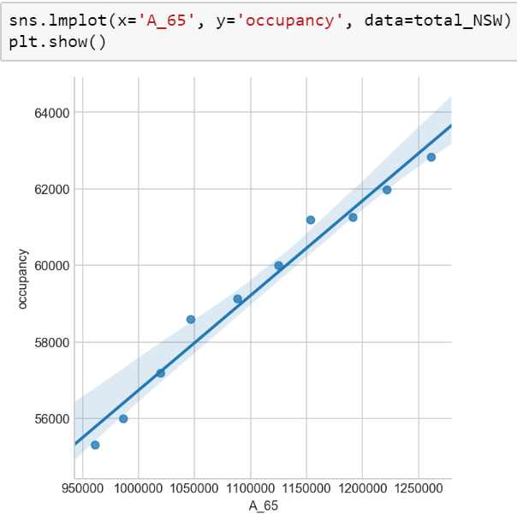
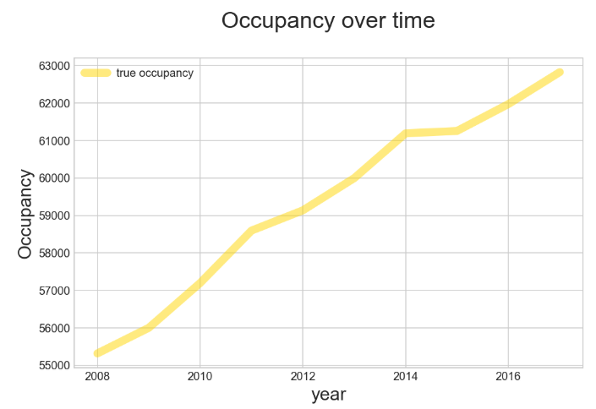
future occupancy

Slide 6



emotional aspects towards aged care
Reviews extracted from whirlpool forums
Applied textblob on the reviews
Used the sentiment function in Textblob
analysed positive, neutral or negative reviews

Slide 7
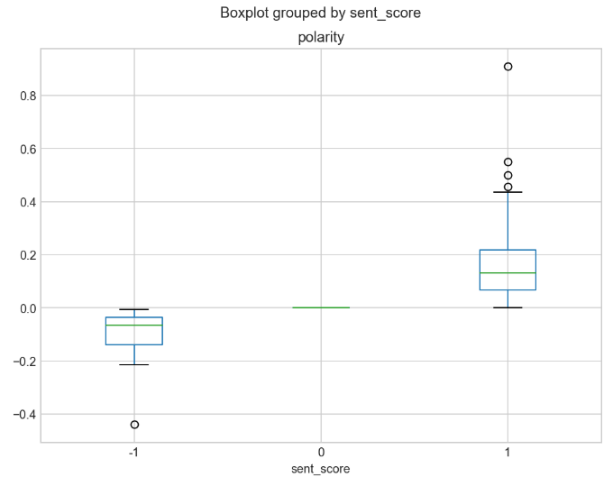




Sentiment analysis on emotional aspects towards aged care
Positive
(67.42%)
Neutral
(8.33 %)
Negative
(24.24%)
Silhouette Score
(76%)

Slide 8
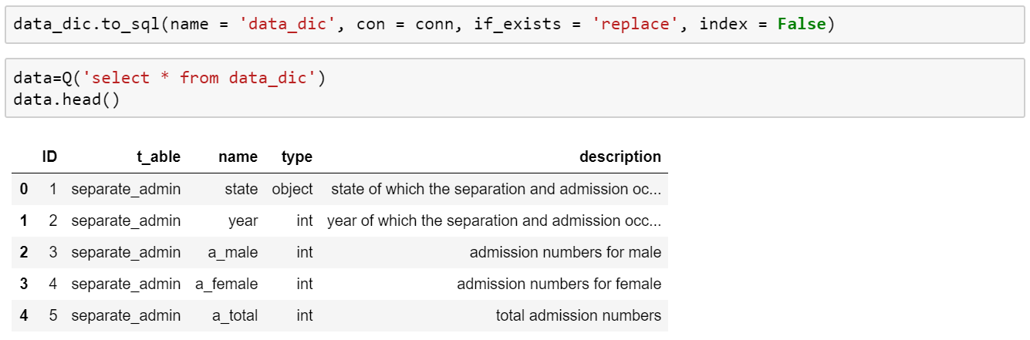
eda activities – build a data dictionary
A data dictionary was created describing the fields that is required
The data dictionary was inserted into a sqllite database

Slide 9
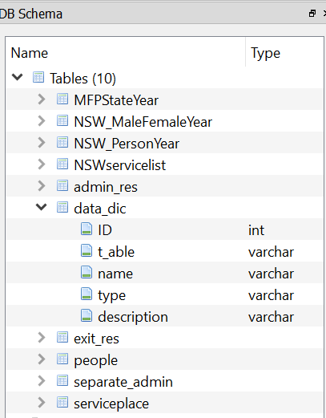
eda activities – upload data into sqllite
the following list of data files were uploaded into the database
Estimated population for nsw
List of nsw RESIDENTIAL aged care facilities
PLACES AND OCCUPANCY LEVELS IN RESIDENTIAL AGED CARE aged care

Slide 10
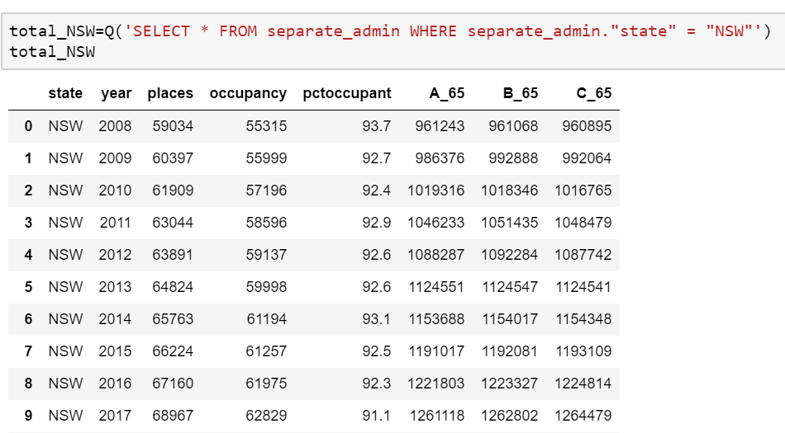
eda activities – population and residential aged care occupancy
In this table, the state of nsw is filtered out. the will be:
State of nsw
Sydney suburbs
population 65 years old and above

Slide 11
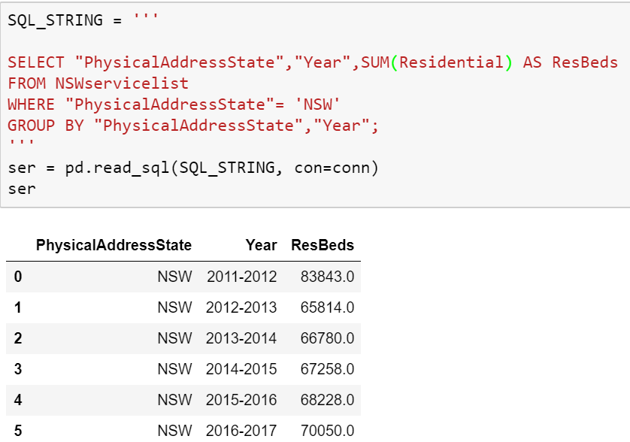
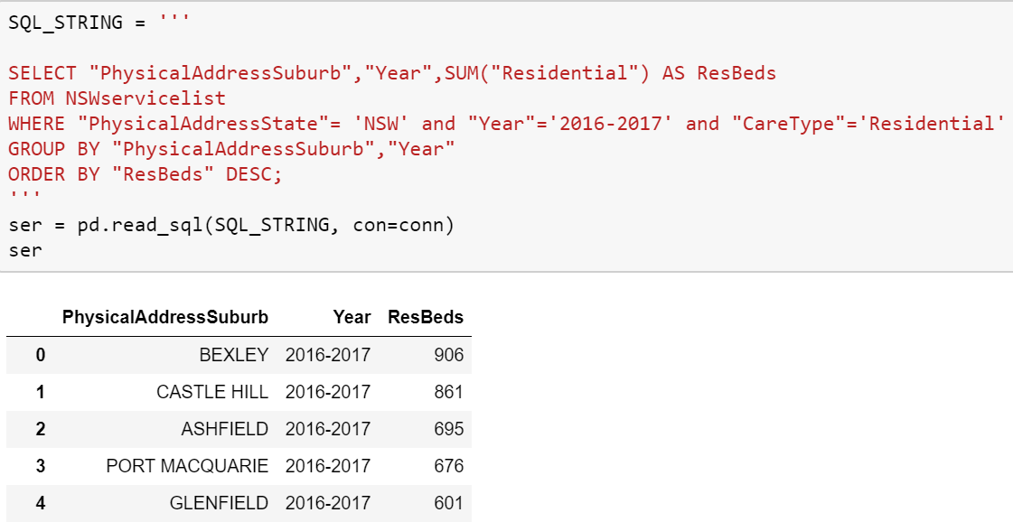
eda activities – occupancy and population
a residential bed is defined as one occupant in a residential home
In 2012 – 2013, there was a reduction in residential beds offered
Bexley suburb has the highest residential beds offered

Slide 12
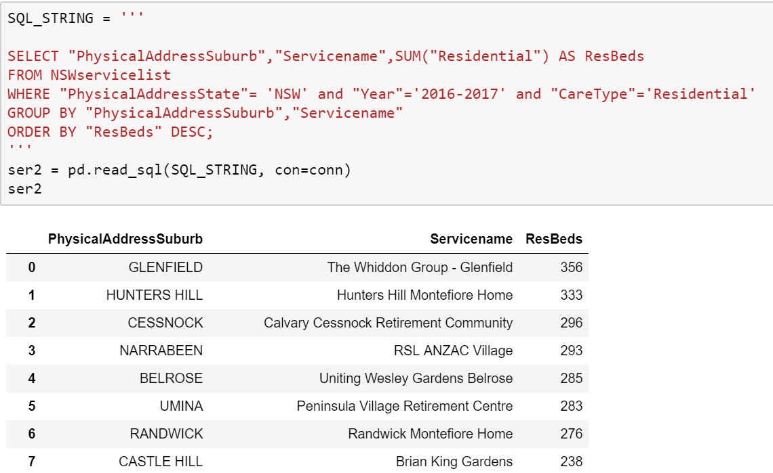
eda activities – occupancy and population
The facility with the highest number of residential beds is in Glenfield
This is not aligned with the suburb that has the highest number of residential beds

Slide 13
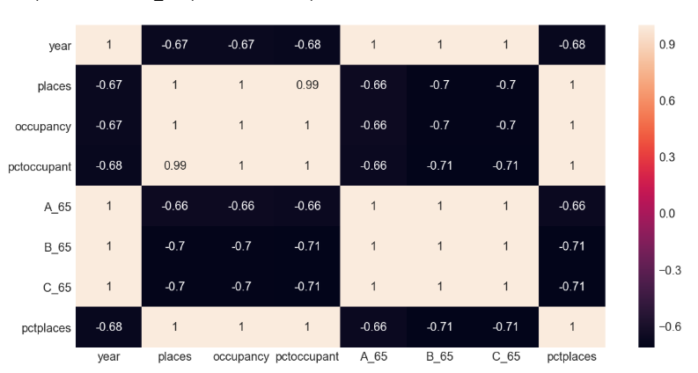
eda activities – occupancy and population- correlation
Definition:
A_65 - population with high fertility
B_65 - population with medium fertility
C_65 – population with low fertility
Residential beds and occupancy has a negative correlation with population

Slide 14
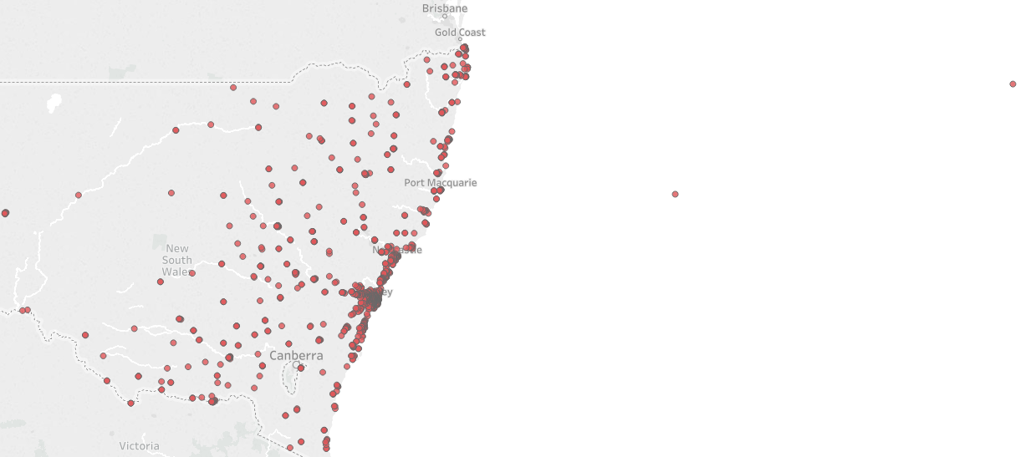
eda activities – Location of nsw facilities
There could be outliers in the data. There are two facilities in the middle of the ocean unless they are on an island – decision to retain the outliers as it is nominal

Slide 15
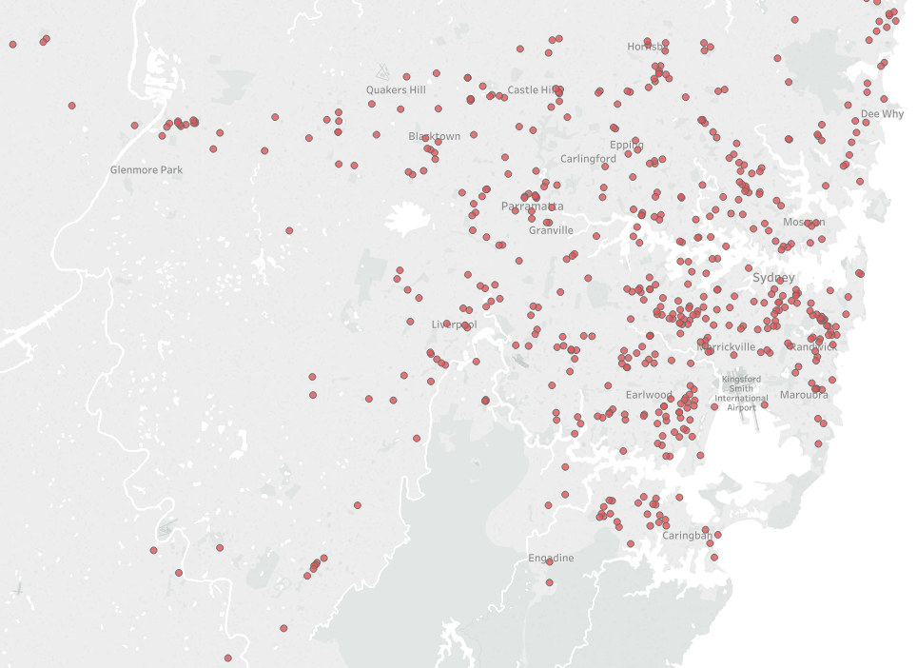
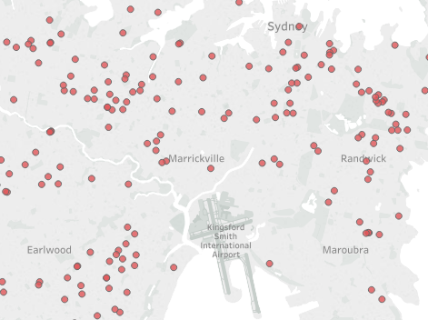
eda activities – Location of Sydney facilities
Facilities are highly concentrated around Sydney

Slide 16
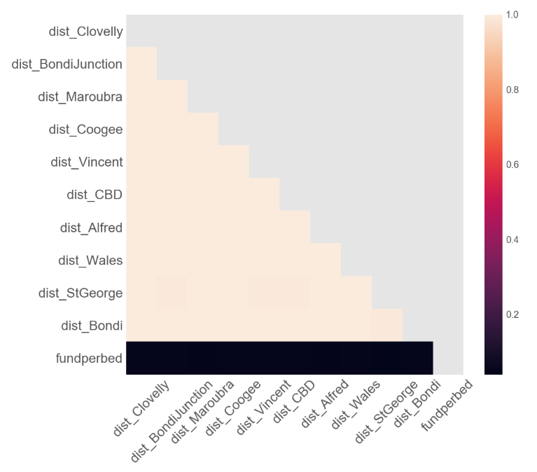


Correlation of the distances
Identify Distance of Sydney facilities from key landmarks
Highly correlated!
Reduced the key landmarks to
Bondi Beach
(151.274292, -33.89084)
Prince of Wales Hospital (Ranwick)
(151.2387, -33.9190)

Slide 17
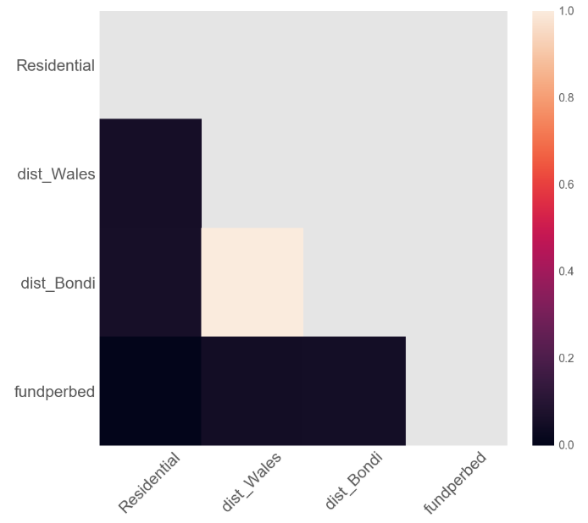

Correlation of the reduced key landmarks
Looks normal
Proceed to identify appropriate models

Slide 18
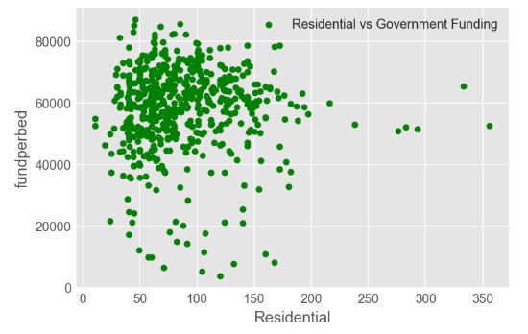
government funding influencers – model evaluations
Target = fund per bed (government funding/ places)
Predictors = residential/ places, distance to hospital and distance to beach
Linear Regression
(-0.22)
Unacceptable results!
Must be +ve
Decision Tree Regressor
(-1.39)

Slide 19
government funding influencers – model evaluations
Regression models do not work!
Proceed to classification models

Slide 20
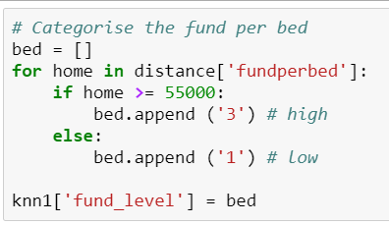
government funding influencers – classification models
Target = fund per bed (government funding/ places)
Predictors = residential/ places, distance to hospital and distance to beach
Made the target categorical
Baseline
(High – 28%
Low – 16%)
Start with logistic regression
SIMPLE!
Numbers are low!

Slide 21
government funding influencers – classification models
Target = high – 3 and low - 2
Predictors = residential/ places, distance to hospital and distance to beach
Modelling PROCESS
Scale and transform
Train, test, split – test size 0.50
Cross validate/ GRIDSEARCH
Fit X and Y
Logistic Regression (LR)
(97.45%)
Support Vector Machine (SVM)
(97.5%)
K Nearest Neighbour (KNN)
(65.61%)
LR & GridSearch
(97.5%)

Slide 22
government funding influencers – why these models?
K Nearest neighbor (KNN)
simple algorithm
stores all available cases and classifies new cases based on a similarity measure (e.g., distance functions)
is automatically non-linear
detect linear or non-linear distributed data
BUT sensitive to outliers – knn score of 65.61% is the lowest of all models
Support vector machine (SVM)
uses a technique called the kernel trick to transform data and finds an optimal boundary between the possible outputs
SVM is good with outliers as it uses the most relevant points to find a linear separation – svm score of 97.52% is the highest of all models
But processing svm is slow

Slide 23
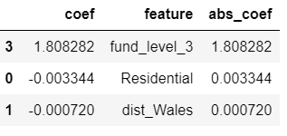
government funding influencers – findings
OR
Prince of Wales Hospital (Ranwick)
(151.2387, -33.9190)
Bondi Beach
(151.274292, -33.89084)
Inference/ findings:
Number of places for each residential aged care facility is an important influencer for government funding
Distance to the hospital and not to the beach is a secondary factor

Slide 24
Next steps
Determine if location affluence and private individual cost of entering a residential aged care impacts government funding received
Sentiments on individual residential aged care facility – difficult as there is insufficient online data

Slide 26
future occupancy – linear regression model
The linear regression model was used:
Simple
Target (occupancy) is continuous
Prediction is based on current occupancy and estimated population in future
Intercept is 31,988.772
Occupancy coefficient is 0.02475279

Slide 27
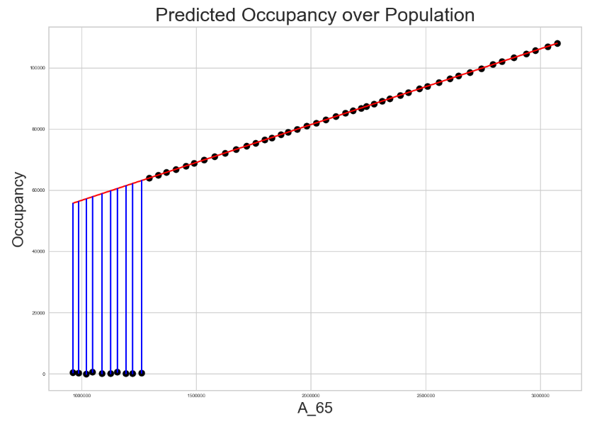
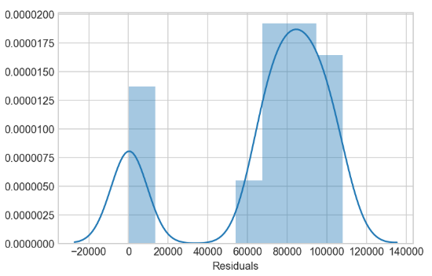
future occupancy – residuals
The residuals do not follow a normal distribution. This could be due to a small dataset

Slide 28
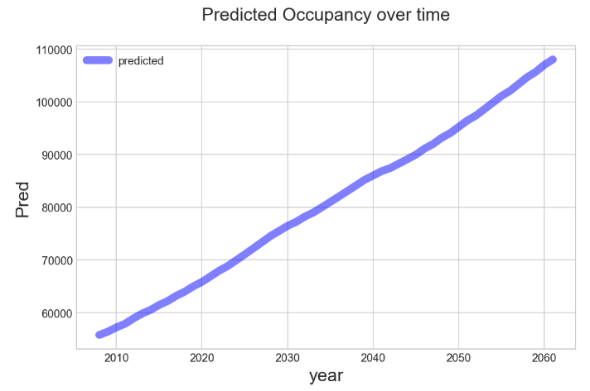
future occupancy – prediction
for every 31,988.772 unit increase of A_65, there is an associated increase of 0.02450508

Slide 29

government funding influencers
Identify Distance of Sydney facilities from key landmarks
Clovelly Beach
(151.266261, -33.913396)
Maroubra Beach
(151.2437, -33.9495)
Prince Alfred Hospital
(151.1826, -33.8895)
Bondi Beach
(151.274292, -33.89084)
Coogee Beach
(151.2555, -33.9190)
St George Hospital
(151.1335, -33.9676)
Bondi Junction
(151.2497, -33.8914)
St Vincent’s Hospital
(151.2208, -33.8805)
Prince of Wales Hospital (Ranwick)
(151.2387, -33.9190)
Sydney CBD
(151.209900, -33.865143)

Slide 30
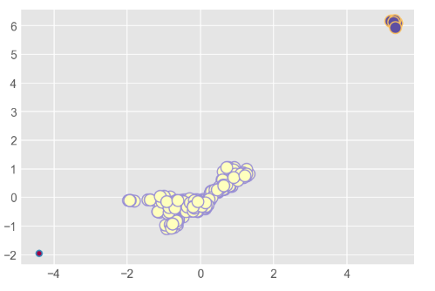
Viable location for A RESIDENTIAL AGED CARE – dbscan
densely populated in one area
yet distant from the rest of our data
supported by the Silhouette Coefficient score 0f 81%
suggest that the new residential aged care facility should be in the vicinity of the high clustered area¶

Slide 31
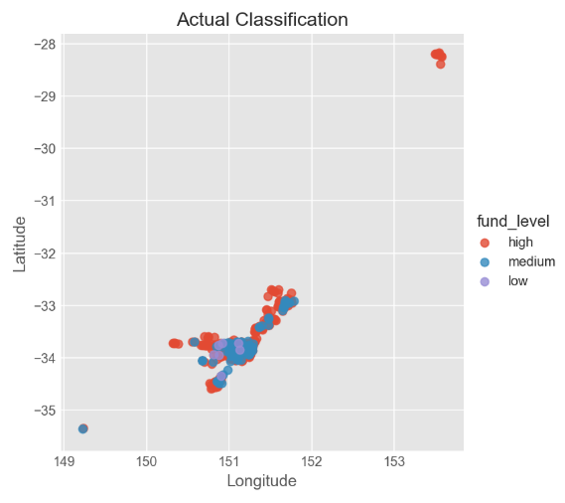
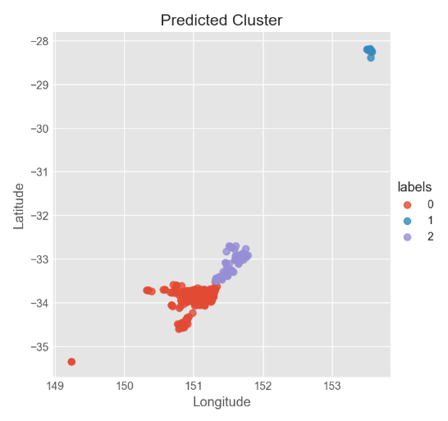
Viable location for A RESIDENTIAL AGED CARE – k means
Assumption: location determines level of funding
Longitude and latitude are seen as independent data points
Y = funding
X = longitude and latitude

